Slide 1
Secure Data Hiding in Image Using Steganography
CAPSTONE PROJECT
Presented By
Student Name : Dhruv Kumar
College Name & Department : Ambedkar DSEU Shakarpur Campus - 1 & Computer Engineering

Slide 2
OUTLINE
Problem Statement
Technology used
Wow factor
End users
Result
Conclusion
Git-hub Link

Slide 3
Problem Statement
This project provides a secure way to hide sensitive information using a graphical user interface (GUI). It combines steganography and encryption to discreetly hide encrypted text inside images. The user-friendly GUI makes it easy to hide and retrieve data, ensuring both secrecy and accessibility.

Slide 4
Technology used
Programming Language: Python
Libraries:Pillow: For image processing.
Cryptography (Fernet): For encryption and decryption of hidden text.
Tkinter: For building the graphical user interface (GUI).
Data Storage: Binary encoding for embedding data into image pixels.

Slide 5
Wow factors
Dual Security Layers: Combines steganography with encryption to ensure data confidentiality and secrecy.
User-Friendly Interface: The GUI simplifies the process of hiding and retrieving text, making it accessible to non-technical users.
Cross-Compatibility: Works with any image format that can be converted to RGB.
Efficient Space Utilization: Embeds data directly into the least significant bits of image pixels without compromising visible image quality.

Slide 6
End users
Businesses: To securely share confidential data such as financial reports or trade secrets.
Individuals: For protecting personal information like passwords or private messages.
Law Enforcement: To covertly embed sensitive information in images for secure transmission.
Researchers: To explore advanced steganographic and encryption techniques

Slide 7
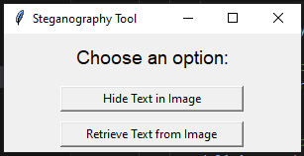
Results
Process of hide data :
Step 1 -> Click on : Hide Text in image

Slide 8
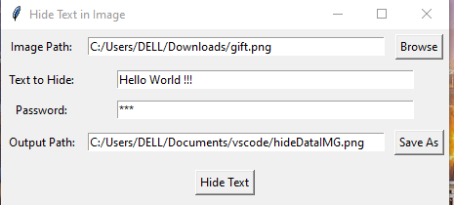
Step 2 -> SELECT IMAGE Step 3 -> ENTER TEXT DATA
Step 4 -> ENTER ENCRPTION PASSWORD
Step 5 -> SELECT OUTPUT PATH

Slide 9
* PROCESS OF RETRIEVE DATA FROM IMAGE
Step 1 -> Click on : Retrieve data from image

Slide 10
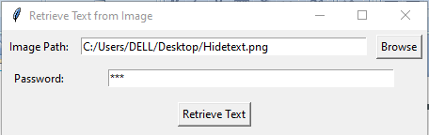
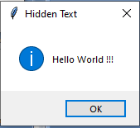
Step 2 -> SELECT IMAGE FROM FILE EXPLORER Step 3 -> ENTER ENCRPTION PASSWORD
Step 4 -> OUTPUT

Slide 11
Conclusion
This project demonstrates an innovative way to combine cryptography and steganography to enhance secure communication. The GUI-based implementation ensures user accessibility, making it a versatile tool for various applications. By embedding encrypted text in images, the solution provides a secure, invisible layer of data protection.

Slide 12
GitHub Link
Secure Data Hiding in Image Using Steganography https://github.com/dK1925402/AICTE-CYBERSECURITY-INTERNSHIP-PROJECT.git

Slide 13
THANK YOU

